Slide 1
Content Recommendation System
By:Prashant kambi

Slide 2
Pre-processing Data
Standardising data:
Numerical columns have been standardised like Episode count,season count,duration,
One hot encoding data:
Genre of content and gender of user is one hot encoded.
Note : Data is standardised with linear regression model keeping in the mind but Decision tree regressor model is used at the end.

Slide 3
Merging or joining three tables
Tables:
1.Users 2.Relation 3.Content
Table1 = Joining content table and Relation tables on column ‘content_id’
Joining table1 with user on column ‘user_id”

Slide 4
Filtering data
Only the users who have viewed more than 100 contents are retained,this is to avoid bias of a model while training.
Contents with more than 100 ratings are retained,as this helps in recommendation of popular content.

Slide 5
Data point Vectors
Each data point is the concatenation of user vector and content vector
This is considered as independent variable and rating can be considered as output variable or dependent variable.
User vector Content vector

Slide 6
Metric used
The metric chosen is Mean squared error as the problem is regression problem.
Output variable is rating which is continuous variable so the mean squared error and other metrics like absolute mean error etc can be considered.

Slide 7
Models used
Decision tree regressor
Random forest regressor
Both models are tuned with depth of a tree as hyperparameter and optimal depth is chosen.

Slide 8
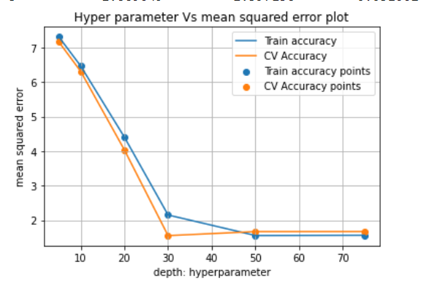
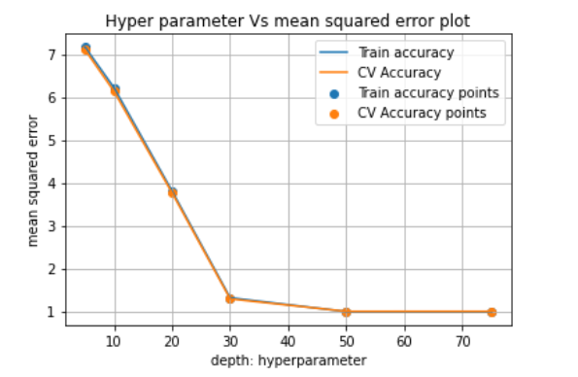
Depth vs mean squared error plots
Decision tree Random forest regressor

Slide 9
Recommendation algorithm
for all users in test data:
retrieve contents not watched by user
Concatenate user vector and content vector
Predict rating on the resultant vector
Retrieve only top 10 rated contents

Slide 10
Prediction on unseen data points
The built model is used to predict the ratings for those content_ids which are not watched by an user.
Amongst those ratings the top 10 ratings and their corresponding content_is are chosen

